Slide 1
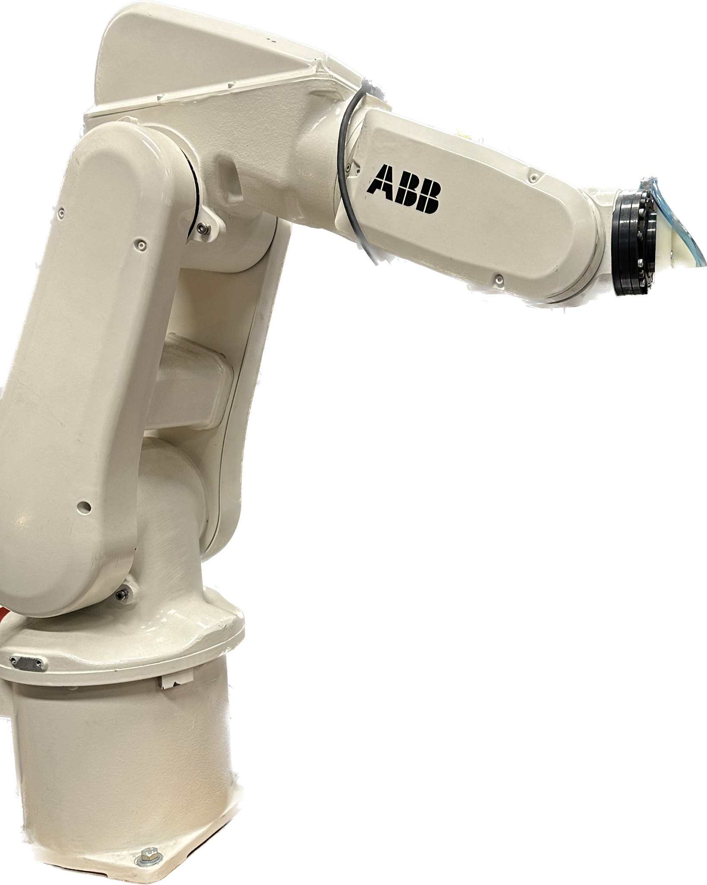
Team F White Robot
ICT Technology for Industry
Jasper Henne
Group members:
Omer Celebi
Inanc Gunalp
Roberto Robledo Cubero

Slide 2
Index
Robot Learning
Program Routines
Loop
Optimization
Laser and future implementations
Test case
Suction Cup
Flowchart

Slide 3
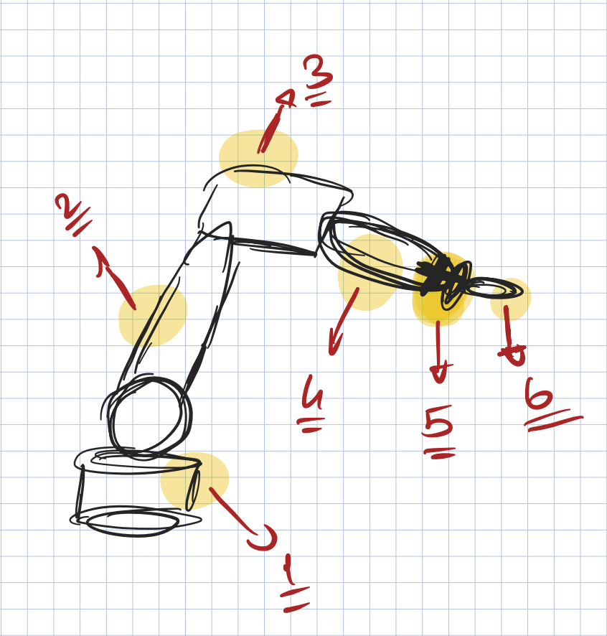
Learning how to use the robot
We began by learning how to use the robot in jogging mode, which required us to understand the movements of the object with the axes and the x, y, and z parameters.
As you can see in the image on the right, we began learning the robot's movements in order to determine how far it could move.

Slide 4
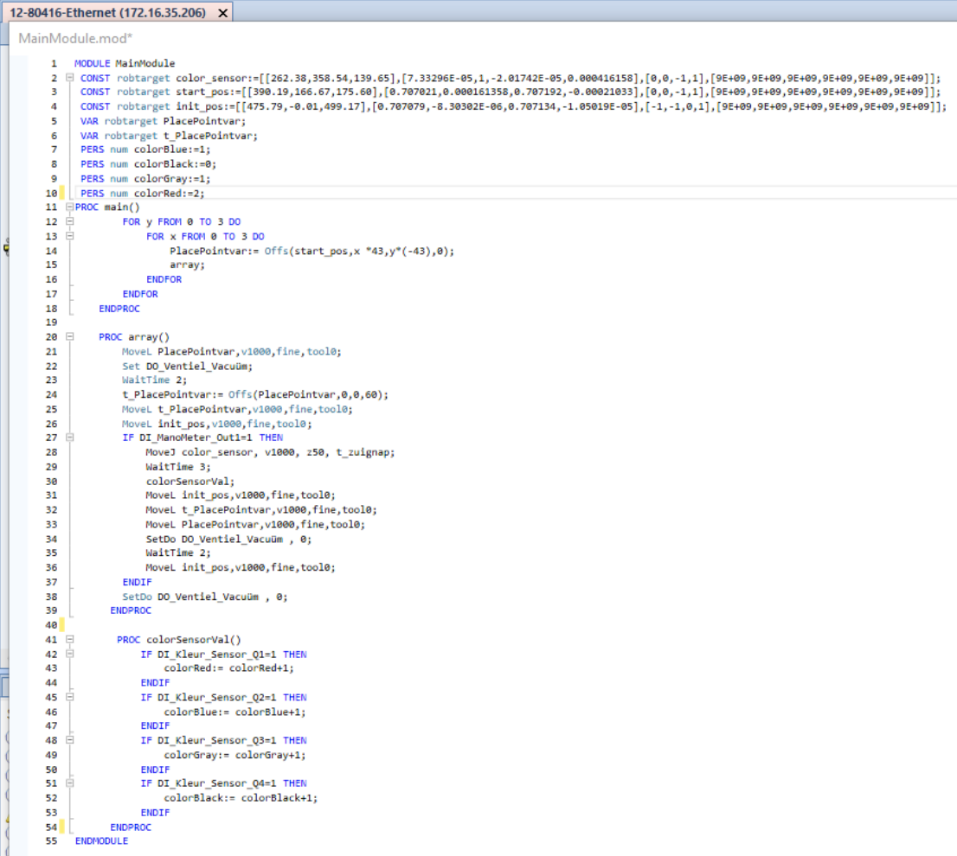
Robot Code
We begin by declaring the initial positions for the color sensor.
The starting position is where the first object starts.
The initial position is used for debugging the suction cup position.
We define variables for different colors, such as colorBlack, colorRed, colorGray, colorBlue and offset variables to save positions PlacePointvar, t_PlacePointvar

Slide 5
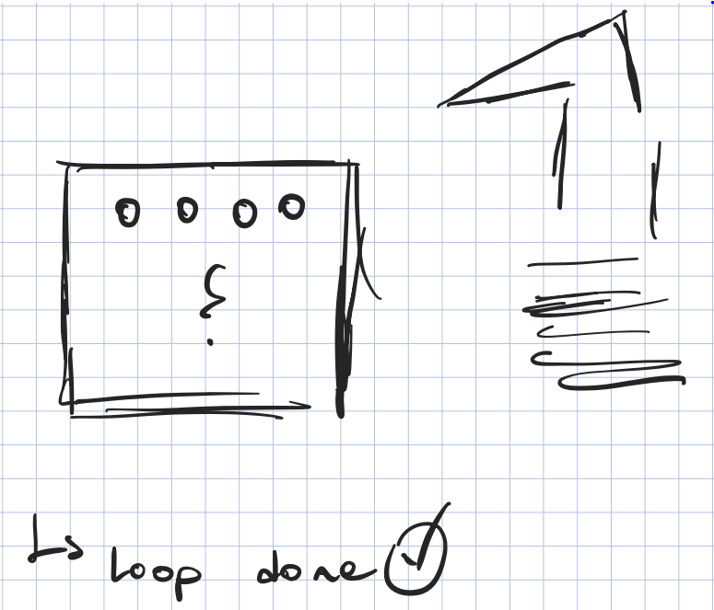
Finishing the loop
We start the array function that goes to the "PlacePointvar" variable position, from where it will start moving to then go to the "t_PlacePointvar" position, and each time the loop goes, it will increase the offset of the positions x and y, and that’s how we make the robot advance in the grid.

Slide 6
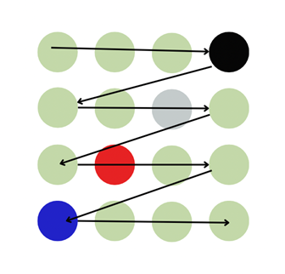
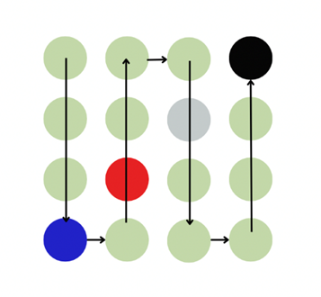
Optimization

Slide 7
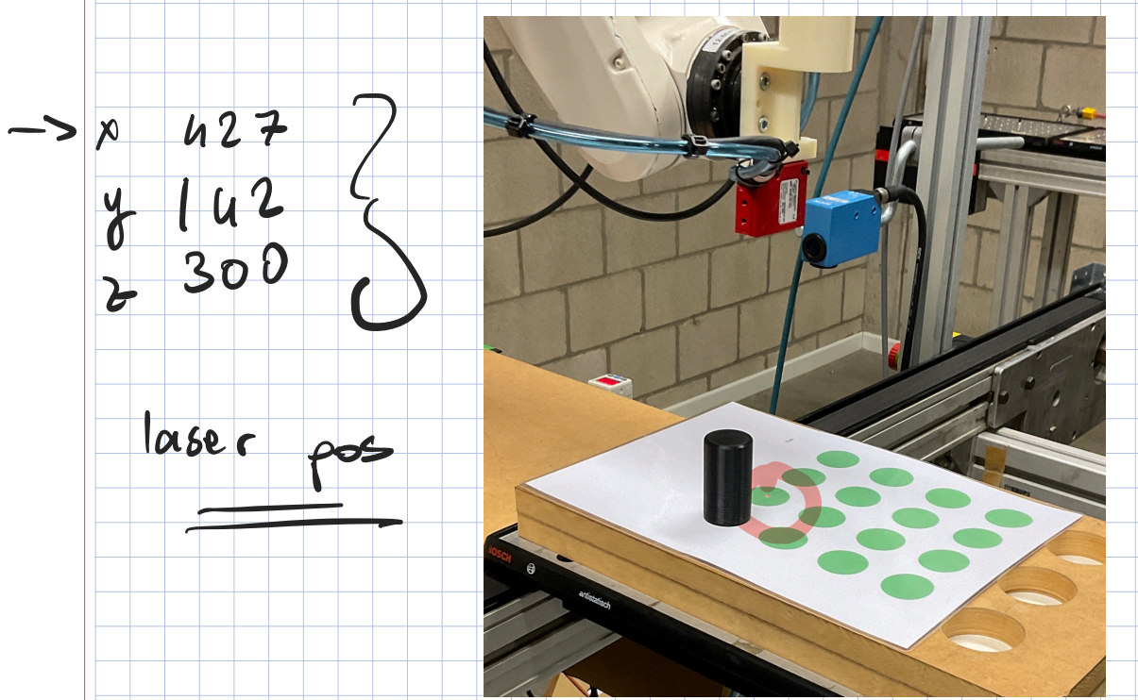



Adjusting the offsets / Test case
No Objects
Objects
Adjust offsets
Organized

Slide 8
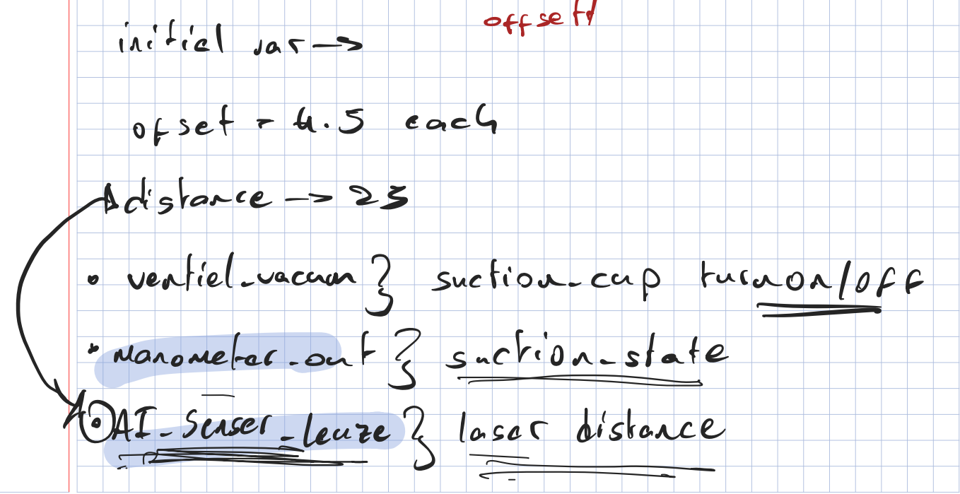
Suction Cup
We were discussing and attempting to implement the suction cup, and we can see how we managed to create the code for the suction cup in the notes that we were taking.
To save resources, we update the code so that when there is no object, the suction cup stops.

Slide 9
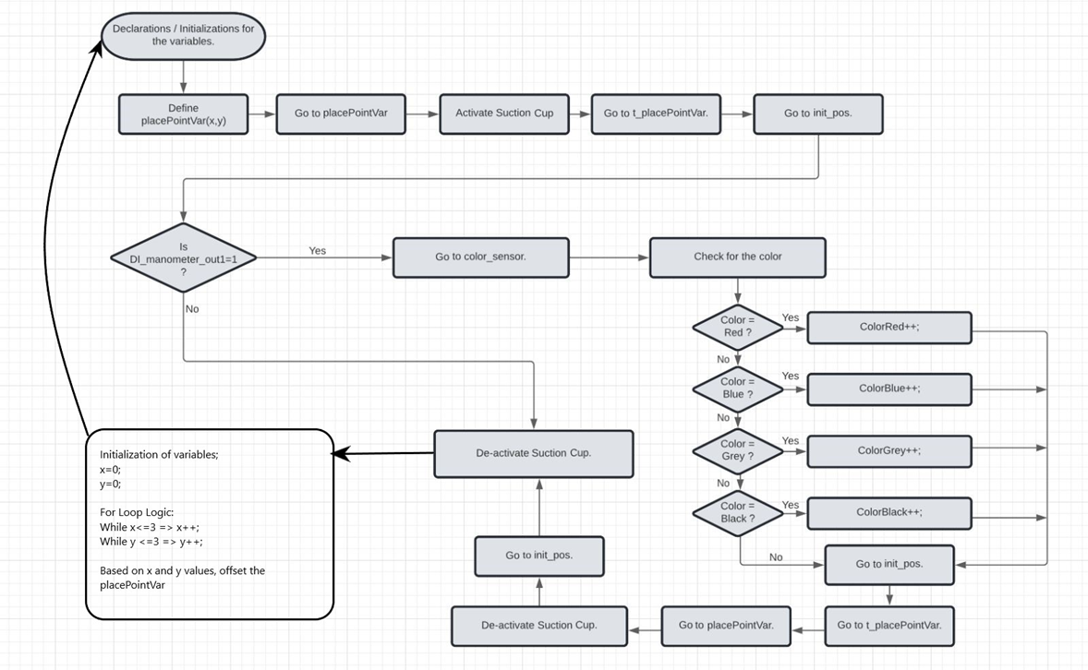
Flowchart

Slide 10
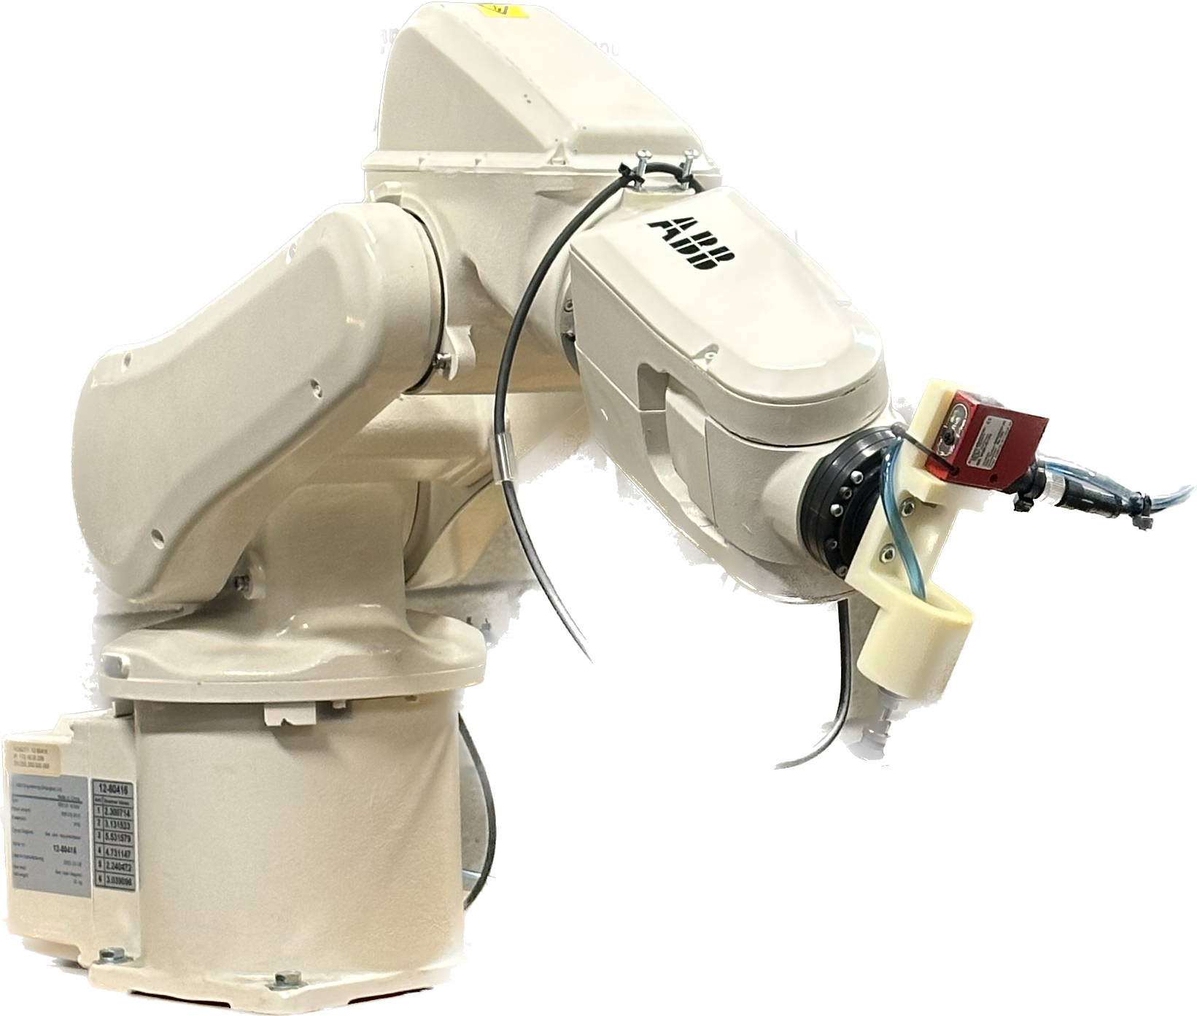
Laser and future implementations
We were attempting to create a program that used the laser as a tool and moved with it at first.
It will function similarly to the previous program, but with the laser detecting the object and switching tools from the laser to the suction cup only if there is an object, making it more complete and efficient.

Slide 11

Video

Slide 12
Thanks!
Group members:
Omer Celebi
Inanc Gunalp
Roberto Robledo Cubero

